Slide 1
Chapter 4
Sample Surveys in the Real World
Lecture Slides

Slide 2
Case Study: Sample Surveys in the Real World 1
An opinion poll talks to 1000 people chosen at random, announces its results, and announces a margin of error. Should we be happy? Perhaps not.
Many polls don’t tell the whole truth about their samples.
The Pew Research Center for the People and the Press does a good job of telling how their samples were obtained.

Slide 3
Case Study: Sample Surveys in the Real World 2
Most polls are taken by telephone, dialing numbers at random to get a random sample of households. After eliminating fax and business numbers:
Never answered phone | 938
Answered but refused | 678
Not eligible: no persons aged 18 or older, or language barrier | 221
Incomplete interview | 42
Complete interview | 1000
Total Called | 2879

Slide 4

Case Study: Sample Surveys in the Real World 3
Out of 2879 working residential phone numbers, 33% never answered. Of those who answered, 35% refused to talk. The overall rate of nonresponse (people who never answered, refused, or would not complete the interview) was 1658 out of 2879, or 58%.

Slide 5
Case Study: Sample Surveys in the Real World 4
Pew called every number five times over a five-day period, at different times of day and on different days of the week. Many polls call only once, and it is usual to find that over half of those who answer refuse to talk.

Slide 6
Case Study: Sample Surveys in the Real World 5
Although Pew did obtain the desired sample of 1000 people, can we trust the results of this poll to make conclusions about people with residential phones?
Can the results of the poll be extended to people who only have cell phones?
By the end of this chapter, you will learn how to answer these questions.

Slide 7
How Sample Surveys Go Wrong
Random sampling eliminates bias in choosing a sample and allows control of variability.
When we see the magic words randomly selected and margin of error, do we know we have trustworthy information before us?
Sampling in the real world is more complex and less reliable than choosing an SRS from a list of names in a textbook exercise.
Confidence statements do not reflect all the sources of error that are present in practical sampling.

Slide 8
Errors in Sampling
Sampling errors are errors caused by the act of taking a sample. They cause sample results to be different from the results of a census.
Random sampling error is the deviation between the sample statistic and the population parameter caused by chance in selecting a random sample. The margin of error in a confidence statement includes only random sampling error.
Nonsampling errors are errors not related to the act of selecting a sample from the population. They can be present even in a census.

Slide 9
Errors in Sampling (continued)
Sampling Errors
Caused by the act of taking a sample
Cause sample results to be different from the results of a census
Nonsampling Errors
Error not related to the act of selecting a sample from the population
Can even be present in a census

Slide 10
1. Sampling Errors
A. Random Sampling Error
Deviation between the statistic and parameter
Caused by chance in selecting a random sample
ONLY error accounted for in the margin of error in a confidence statement
B. Bad Sampling Methods
Convenience and voluntary response samples
An incomplete sampling frame can cause undercoverage, where certain groups of the population are left out.

Slide 11
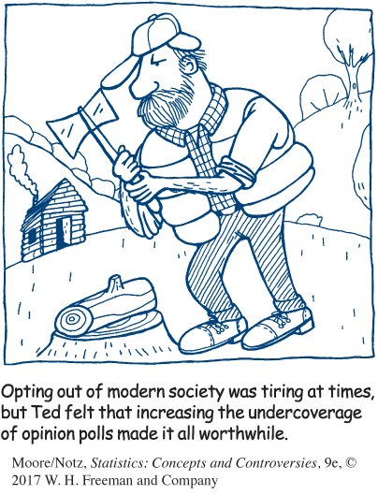
Example: Undercoverage
Most opinion polls can’t afford to attempt full coverage of the population of all adult residents of the United States.
The interviews are done by telephone, thus missing the 2% of households without phones.

Slide 12
Example: Undercoverage (continued)
Only households are contacted, so students in dormitories, prison inmates, most members of the armed forces, the homeless, and people staying in shelters are left out.
Many polls interview only in English, which leaves some immigrant households out of their samples.

Slide 13
2. Nonsampling Errors
A. Processing Errors
Mistakes in mechanical tasks such as arithmetic or data entry
B. Poorly Worded Questions
Question is slanted to favor one response over the other

Slide 14
2. Nonsampling Errors (continued)
C. Response Error
Response from an individual in the survey that is inaccurate from lying, bad memory, etc.
D. Nonresponse Error
Failure to obtain data from an individual selected for a sample

Slide 15
Poorly Worded Questions
Look at the difference with a few changed words!
Is our government providing too much money for welfare programs?
44% said yes
Is our government providing too much money for assistance to the poor?
13% said yes

Slide 16
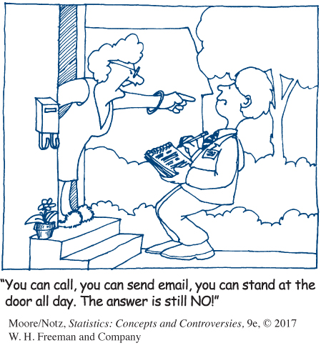
What the Margin of Error Can’t Say
The announced margin of error for a sample survey covers only random sampling error.
Undercoverage, nonresponse, and other practical difficulties can cause large bias that is not covered by the margin of error.

Slide 17
Other Random Sampling Methods
With an SRS, because each sample of size n has the same chance of being selected, we cannot obtain information for separate groups of individuals (e.g., individuals of different gender, race, income class, or religion).
Identify some separate groups we may want to hear from when asking the following question: “Do you think our health-care system works well?”

Slide 18
How to Live with Nonsampling Errors
Substitute other households for the nonresponders. Because nonresponse is higher in cities, replacing nonresponders with other households in the same neighborhood may reduce bias.
Once the data are in, all professional surveys use statistical methods to weight the responses in an attempt to correct sources of bias.

Slide 19
Sample Design in the Real World 1
The Current Population Survey (CPS) samples U.S. households. They sample in stages.
The nation is divided into 2007 geographic areas called primary sampling units (PSUs); 428 highly populated PSUs are automatically in the sample.
The remaining 1579 are divided into 326 groups, called strata. One PSU is drawn at random to represent each stratum.

Slide 20
Sample Design in the Real World 2
Each of the 754 PSUs in the first-stage sample is divided into census blocks (smaller geographic areas), which are also grouped into strata, based on such things as housing types and minority population.
The households in each block are arranged in order of their location and divided into groups, called clusters, of about four households each.

Slide 21
Sample Design in the Real World 3
The final sample consists of samples of clusters (not of individual households) from each stratum of blocks. Interviewers go to all households in the chosen clusters.
The samples of clusters within each stratum of blocks are also not SRSs.
To be sure that the clusters spread out geographically, the sample starts at a random cluster and then takes, for example, every tenth cluster in the list.

Slide 22
Stratified Random Sampling
Step 1: Divide the sampling frame into
distinct groups of individuals, called strata.
Choose strata because you have an interest in the groups or because the individuals within each group are similar.
Step 2: Take a separate SRS in each stratum and combine these to make up the complete sample.

Slide 23
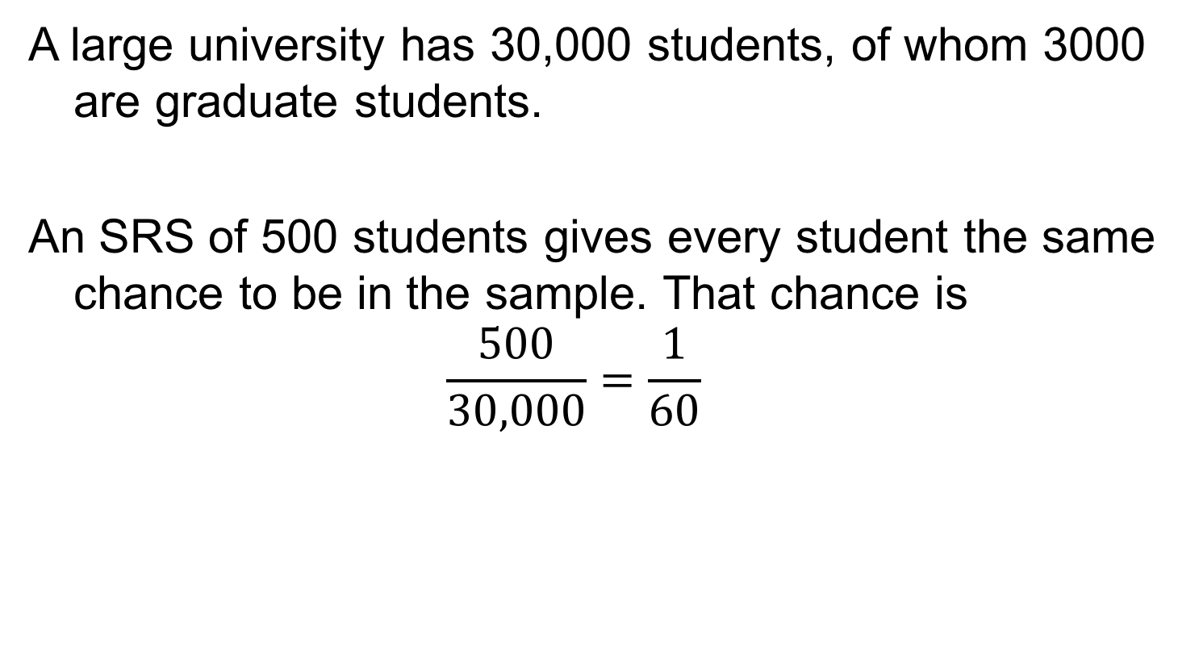
Example: Stratifying a Sample of Students 1
A large university has 30,000 students, of whom 3000 are graduate students.
An SRS of 500 students gives every student the same chance to be in the sample. That chance is
$$\frac{500}{30,000}=\frac{1}{60}$$

Slide 24
Example: Stratifying a Sample of Students 2
To make sure we have a certain number of
grad students (200) and undergraduate
students (300) represented, we can stratify.
Label the graduate students 0001 to 3000 and use Table A to select an SRS of 200.
Then label the undergraduates 00001 to 27000 and use Table A a second time to select a sample of 300 of them.

Slide 25
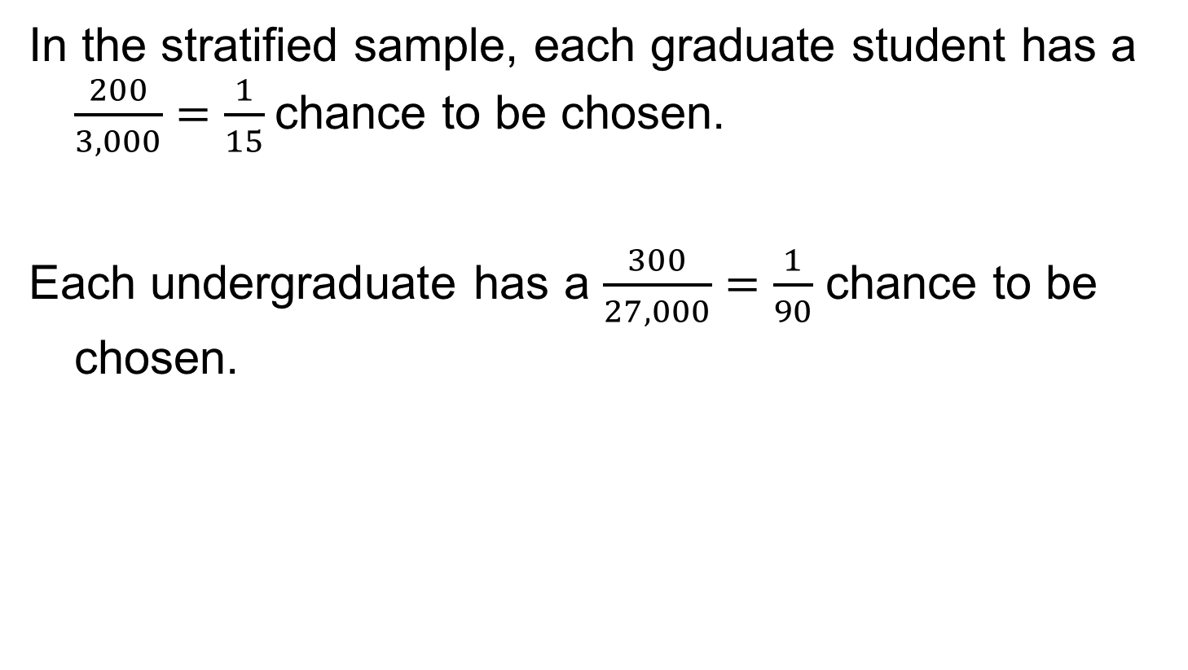
Example: Stratifying a Sample of Students 3
In the stratified sample, each graduate student has a $\frac{200}{3,000}=\frac{1}{15}$chance to be chosen.
Each undergraduate has a $\frac{300}{27,000}=\frac{1}{90}$ chance to be chosen.

Slide 26
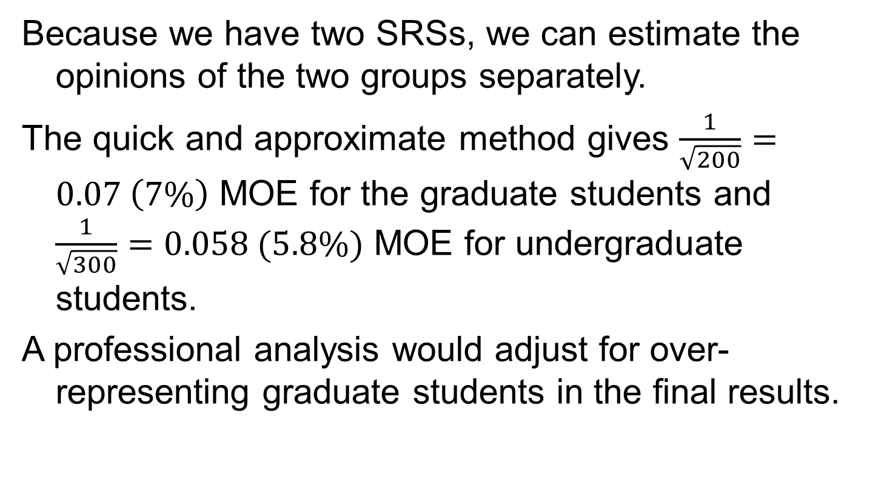
Example: Stratifying a Sample of Students 4
Because we have two SRSs, we can estimate the opinions of the two groups separately.
The quick and approximate method gives $\frac{1}{\sqrt{200}}=0.07 \left(7\%\right)$ MOE for the graduate students and $\frac{1}{\sqrt{300}}=0.058 (5.8\%)$ MOE for undergraduate students.
A professional analysis would adjust for over-representing graduate students in the final results.

Slide 27
The Challenge of Internet Surveys
Using the Internet for “Web surveys” is becoming
increasingly popular.
Advantages:
Easy to collect large amounts of data
Costs less money
Allows for delivery of multimedia content
Disadvantages:
Not easy to do well
Voluntary response, undercoverage, nonresponse

Slide 28
Example: Doctors and Placebos
A Web survey of doctors in internal medicine departments at Chicago-area medical schools was possible because almost all doctors had listed e-mail addresses.
An e-mail was sent to each doctor explaining the purpose of the study, promising anonymity, and giving an individual a Web link for response.
Result: 45% of respondents said they sometimes use
placebos in their clinical practice.
This is a Web survey done well, since there was a list of all doctors’ e-mail addresses and it offered anonymity to reduce the chance of response errors.

Slide 29
Probability Samples
A probability sample is a sample chosen by chance. We must know what samples are possible and what chance, or probability, each possible sample has.
Some probability samples, such as stratified samples, don’t allow all possible samples from the population and may not give an equal chance to all the samples they do allow. As such, not all probability samples are random samples.

Slide 30
Questions to Ask before You Believe a Poll
Who carried out the survey? Even a political party should hire a professional sample survey firm whose reputation demands that they follow good survey practices.
What was the population? That is, whose opinions were being sought?
How was the sample selected? Look for mention of random sampling.
How large was the sample? Even better, find out both the sample size and the margin of error within which the results of 95% of all samples drawn, as this one was, would fall.

Slide 31
Questions to Ask before You Believe a Poll (continued)
What was the response rate? That is, what percentage of the original subjects actually provided information?
How were the subjects contacted? By telephone? Mail? Face-to-face interview?
When was the survey conducted? Was it just after some event that might have influenced opinion?
What were the exact questions asked?

Slide 32
Statistics in Summary 1
Sampling in the real world is complex. Even professional sample surveys don’t give exactly correct information about the population.
There are many potential sources of error in sampling. The margin of error announced by a sample survey covers only random sampling error, the variation due to chance in choosing a random sample.

Slide 33
Statistics in Summary 2
Other types of error are in addition to the margin of error and can’t be directly measured. Sampling errors come from the act of choosing a sample.
Random sampling error and undercoverage are common types of sampling error.
Undercoverage occurs when some members of the population are left out of the sampling frame, the list from which the sample is actually chosen.

Slide 34
Statistics in Summary 3
The most serious errors in most careful surveys, however, are nonsampling errors. These have nothing to do with choosing a sample; they are present even in a census.
The single biggest problem for sample surveys is nonresponse: subjects can’t be contacted or refuse to answer.

Slide 35
Statistics in Summary 4
Mistakes in handling the data (processing errors) and incorrect answers by respondents (response errors) are other examples of nonsampling errors.
Finally, the exact wording of questions has a big influence on the answers.

Slide 36
Statistics in Summary 5
People who design sample surveys use statistical techniques that help correct nonsampling errors, and they also use probability samples more complex than simple random samples, such as stratified samples.
You can assess the quality of a sample survey quite well by just looking at the basics: use of random samples, sample size and margin of error, the rate of nonresponse, and the wording of the questions.

